Slide 1
Computer History

Slide 2
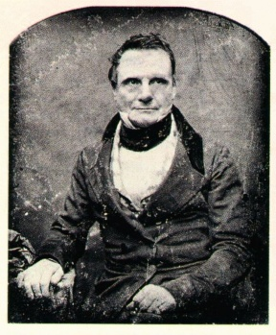

Charles Babbage
English inventor
1791-1871
taught math at Cambridge University
invented a viable mechanical computer equivalent to modern digital computers

Slide 3
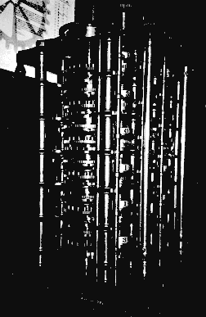

Babbage’s first computer
built in early 1800’s
  special purpose calculator
  naval navigation charts
difference engine

Slide 4
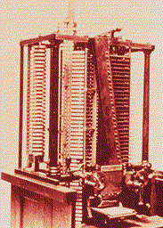
Babbage’s second computer
Analytical engine
  general-purpose
  used binary system
  punched cards as input
  branch on result of previous instruction
  Ada Lovelace (first programmer)
  machined parts not accurate enough
  never quite completed
analytical engine, 1834

Slide 5
invention of the light bulb, 1878
Sir Joseph Wilson Swan
  English physicist and electrician
  first public exhibit of a light bulb in 1878
Thomas Edison
  American inventor, working independently of Swan
  public exhibit of a light bulb in 1879
  had a conducting filament mounted in a glass bulb from which the air was evacuated leaving a vacuum
  passing electricity through the filament caused it to heat up, become incandescent and radiate light
  the vacuum prevented the filament from oxidizing and burning up

Slide 6
Edison’s legacy
Edison continued to experiment with light bulbs
in 1883, he detected electrons flowing through the vacuum of a light bulb
  from the lighted filament
  to a metal plate mounted inside the bulb
this became known as the Edison Effect
he did not develop this any further

Slide 7

invention of the diode (late 1800’s)
John Ambrose Fleming
  an English physicist
  studied Edison effect
  to detect radio waves and to convert them to electricity
developed a two-element vacuum tube
  known as a diode
electrons flow within the tube
  from the negatively charged cathode
  to the positively charged anode
today, a diode is used in circuits as a rectifier

Slide 8
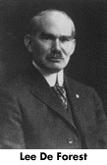


the switching vacuum tube, 1906
Lee de Forest introduced a third electrode into the vacuum tube
  American inventor
the new vacuum tube was called a triode
  new electrode was called a grid
this tube could be used as both an amplifier and a switch
many of the early radio transmitters were built by de Forest using triodes
triodes revolutionized the field of broadcasting
their ability to act as switches would later be important in digital computing

Slide 9
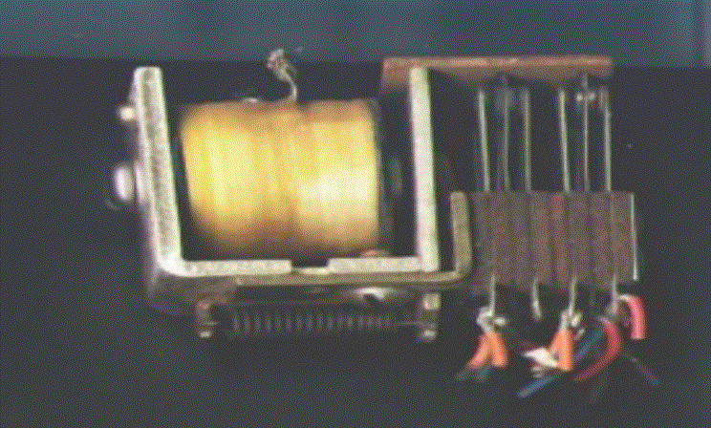


on/off switches in digital computers
earliest:
  electromechanical relays
    solenoid with mechanical contact points
    physical switch closes when electricity animates magnet
1940’s:
  vacuum tubes
    no physical contacts to break or get dirty
    became available in early 1900’s
    mainly used in radios at first
1950’s to present
  transistors
    invented at Bell Labs in 1948
    John Bardeen, Walter Brattain, and William Shockley
    Nobel prize, 1956

Slide 10
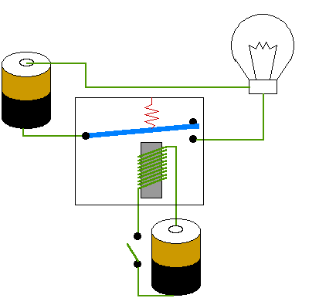
electromechanical relay

Slide 11
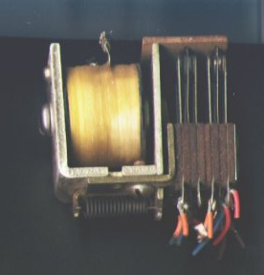
photo of an electromechanical relay

Slide 12
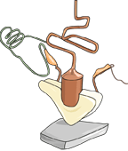
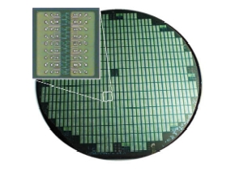
transistor evolution
first transistor made from materials including a paper clip and a razor blade
later packaged in small IC’s
eventually came VLSI
  Very Large Scale Integration
  millions of transistors per chip

Slide 13
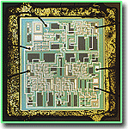
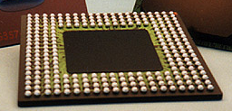
the integrated circuit (IC)
invented separately by 2 people ~1958
  Jack Kilby at Texas Instruments
  Robert Noyce at Fairchild Semiconductor (1958-59)
1974
  Intel introduces the 8080 processor
  one of the first “single-chip” microprocessors

Slide 14
IC’s are fabricated many at a time

Slide 15
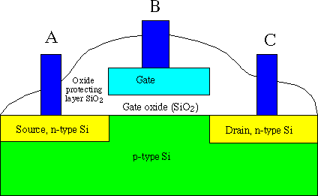
functional view of transistor contents

Slide 16
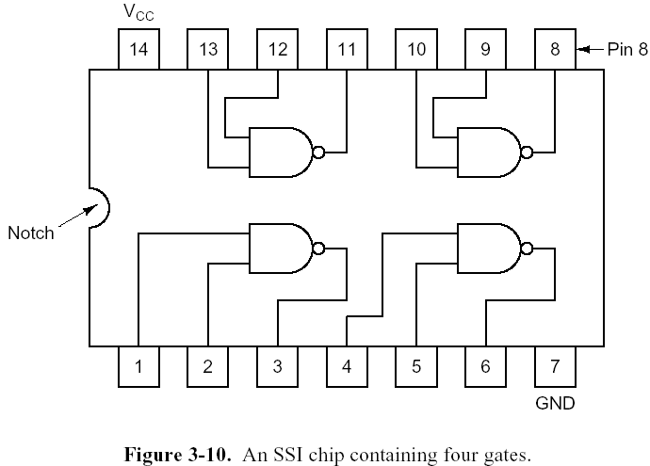
a TTL chip

Slide 17

Moore’s law
deals with steady rate of miniaturizion of technology
named for Intel co-founder Gordon Moore
not really a law
  more a “rule of thumb”
    a practical way to think about something
observation that chip density about doubles every 18 months
  also, prices decline
  first described in 1965
  experts predict this trend might continue until ~2020
  limited when size reaches molecular level

Slide 18
transistors - building blocks of computers
microprocessors contain many transistors
  (ENIAC): 19,500 vacuum tubes and relays
  Intel 8088 processor (1st PC): 29,000 transistors
  Intel Pentium II processor: 7 million transistors
  Intel Pentium III processor: 28 million transistors
  Intel Pentium 4 processor: 42 million transistors
logically, each transistor acts as an on-off switch
transistors combined to implement logic gates
  AND, OR, NOT
gates combined to build higher-level structures
  adder, multiplexor, decoder, register, …

Slide 19
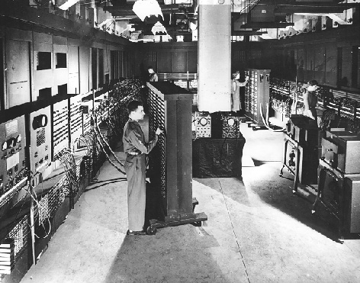
Electrical Numerical Integrator and Computer (ENIAC), 1940’s
an early computer
developed at UPenn
Size: 30’ x 50’ room
18,000 vacuum tubes
1500 relays
weighed 30 tons
designers
  John Mauchly
  J. Presper Eckert

Slide 20
Intel 8088 microprocessor (single chip)
used in first IBM personal computer
IBM PC released in 1981
4.77 MHz clock
16 bit integers, with an 8-bit data bus
  transfers took two steps (a byte at a time)
  1 Mb of physical memory address limitation
8-bit device-controlling chips
29,000 transistors
3-micron technology
speed was 0.33 MIPS
later version had 8 MHz clock
  speed was 0.75 MIPS.
Pentium 4 chip has
42 million transistors
electrical paths now
as small as .13 micron

Slide 21
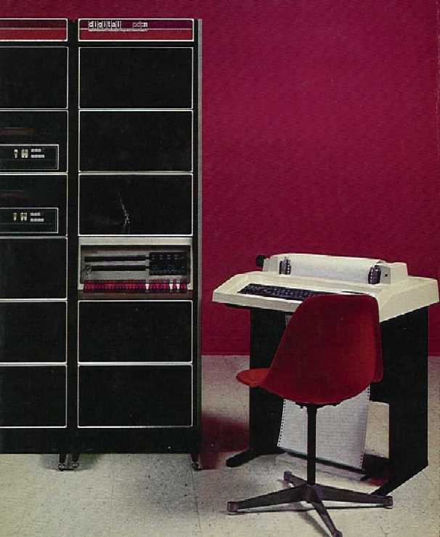
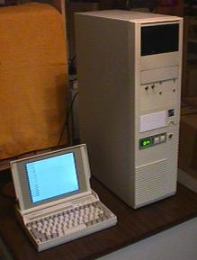
Moore’s Law example
DEC
LSI-11,
Early 1980’s
DEC
PDP-11,
mid 1970’s
These 2 computers were functionally equivalent.

Slide 22

the end

